Slide 1
Multi-issue Processor
Jie Zhang
jiez@pku.edu.cn
[Adapted from EE488, Myoungsoo Jung, KAIST]
Notes:
需要加入RAS的解释
需要加入true dependency，anti-dependency和output dependency的解释

Slide 2
Remind: Performance w/ Pipelining
We finish one instruction per cycle
After the initial warm-up period
Instruction throughput
Latch at end of each stage adds latency
Longest stage determines clock cycle time
Example:
IF | 1.0 ns
ID | 0.6 ns
EX | 0.9 ns
MEM | 1.2 ns
WB | 0.4 ns
Design | Cycle time | Inst/Cycle
Single cycle |  | 1
Pipeline |  | 1
4.1 ns (sum)
1.2 ns (max)
Speedup due to pipelining: 3.42
Note: ideally it would be 5

Slide 3
Then, How about using Deeper pipelines?
Called Super-pipelining
Goal: Speedup ~ number of stages
Idea: let’s have a lot of stages
Vaguely defined by deep pipelining
How about > 30? Think Pentium 4.
What does this mean by?
While splitting a stage into multiple sub-stages, the machine can issue a new instruction every minor cycle
If one splits the stage into “m” sub-stages, the clock cycle period “T” should be reduced by “T/m”
T
Fetch
Decode
Inst
F1
F2
D1
D2
E1
E2
T/m

Slide 4
Ideal Case of Super-pipelining
The super-pipeline produces the result every T/m clock cycle
Instr. i
Fetch
Decode
Inst
Instr. i+1
Fetch
Decode
Inst
Pipelining
Instr. i+2
Fetch
Decode
Inst
Instr. i+3
Fetch
Decode
Inst
T/m
Instr. i
F1
F2
D1
D2
E1
E2
Super-
Pipelining
Instr. i+1
F1
F2
D1
D2
E1
E2
Instr. i+2
F1
F2
D1
D2
E1
E2
Gain
Instr. i+3
F1
F2
D1
D2
E1
E2
Cycle1
Cycle2
Cycle3
Cycle4
Cycle5

Slide 5
Problems of Super-pipelining
Require a really high clock frequency!
Instruction dependences (similar to pipelining, but much more critical)
Control dependences
Data dependences
Result: Branch!
Value from memory arrives
comparison
beq
1
2
3
4
5
6
32
LW R1,0(R2)
1
2
3
4
5
40
Instr1
1
2
3
4
5
6
7
ADD R2,R3,R1
1
2
3
25
Instr2
2
1
3
4
5
6
Value of R1 needed
Instr3
1
2
3
4
5
Stall 15 cycles!
Flush 31 Instr.!
Instr31
1
Notes:
Data dependences: load/use hazard requires 1 stall in 5-stage pipeling

Slide 6
There is an Optimal Number of Stages
For a given architecture and associated instruction set
Also need to consider workload characteristics
Diminishing Returns: Increasing the number of stages over this limit reduces the overall performance
Around ~15 stages
Source: “Runtime Aware Architectures”, Mateo Valero, HiPEAC CSW 2014

Slide 7
Another Instruction-Level Parallelism (ILP)
Internal of operation principle of ILP-processors
Pipelined operation
Parallel operation
EX₁
EX₂
EX₃
Instr
EX₁
EX₂
EX₃
Pipelined processors
Orthogonal Design
Superscalar / VLIW

Slide 8
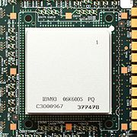
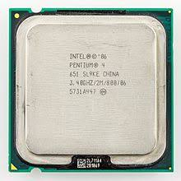
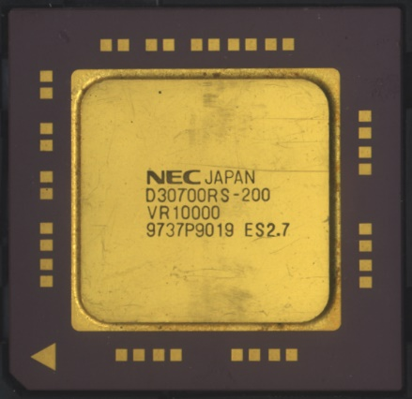
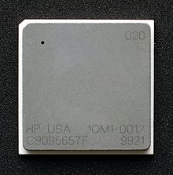
Super-scalar
Dynamic multiple-issue processors (decision making at run time by the hardware)
IBM Power 3
Pentium 4
MIPS R10K
HP PA 8500

Slide 9
Dynamic Multiple Issue Machine (Superscalar)
Superscalar architectures allow several instructions to be issued and completed per clock cycle
A superscalar architecture consists of a number of pipelines that are working in parallel (N-way Superscalar)
Can issue up to N instructions per cycle
Clock
Conceptual N-Way Superscalar
Register File
InstructionMemory
A1
Addr
Data
PC
A2
RD1
A3
Data
Memory
RD4
RD1
A4
A1
RD2
A5
ALUs
A2
A6
RD2
Multi mux
RD5
WD3
Multi ALUs
WD1
WD6
WD2
Multi port
Multi port
Notes:
Assume we have two-way superscalar

Slide 10
Super-pipelining vs. Super-scalar
Note that super-pipelining is orthogonal with super-scalar
Instr. i
F1
F2
D1
D2
E1
E2
Super-
Pipelining
Instr. i+1
F1
F2
D1
D2
E1
E2
Instr. i+2
F1
F2
D1
D2
E1
E2
Instr. i+3
F1
F2
D1
D2
E1
E2
Parallel execution
Instr. i
Fetch
Decode
Inst
2-way
Super-
scalar
Instr. i+1
Fetch
Decode
Inst
Instr. i+2
Fetch
Decode
Inst
Gain
Instr. i+3
Fetch
Decode
Inst
Cycle1
Cycle2
Cycle3
Cycle4
Cycle5

Slide 11
Superscalarity is Important!
Ideal case of N-way Super-scalar
All instructions were independent
Speedup is “N” (Superscalarity)
Fetch
Decode
Inst
Fetch
Decode
Inst
Fetch
Decode
Inst
What if all instructions are dependent?
No speed up, super-scalar brings nothing
(Just similar to pipelining)
Fetch
Decode
Inst
Fetch
Decode
Inst
Fetch
Decode
Inst

Slide 12
Pipelining vs. Super-scaler
Superscalarity ex.: sum of array elements
(assume that load-to-use dependence only take a cycle for the sake of brevity)
Assembly Code
Cannot execute in parallel
C Program
ld $r2, 10($r1)
loop:
Compile
add $r3, $r3, $r2
sum += a[i--]
sub $r1, $r1, 1
Parallel execution
bne $r1, $r0, loop
Cannot execute in parallel
Pipelining
architecture
Fetch
Decode
ld
Fetch
Decode
add
Fetch
Decode
sub
Fetch
Decode
bne
$r2
$r1
Superscaler
architecture
Fetch
Decode
ld
Fetch
Decode
add
$r3
We should find out independent instructions!
Fetch
Decode
sub
Fetch
Decode
bne
Notes:
ld and sub: write after read hazard
sub and bne: read after write hazard

Slide 13
From Sequential Instructions to Parallel Execution
Q1. How’s the ability of a superscalar processor to execute instructions in parallel determined?
The number and nature of parallel pipelines
The mechanism that the processor uses finds independent instructions (which can be executed in parallel)
The policies used for the instruction execution are characterized by the following factors
➔ The order in which instructions are issued for execution (In-Order/Out-Order)
➔ The order in which instructions are completed (In-Order/Out-Order)
Q. BTW, what’s the meaning of controlling instruction completion?
Determine when the instruction write results into registers and memory locations
Notes:
How many parallel data paths?
How to identify the independent instructions?

Slide 14
Execute in Parallel
But Make Sure Sequential Order
Execute and complete instructions in their sequential order (but a little chance to execute in parallel)
To improve parallelism, superscalar has to look ahead and try to find independent instructions to execute in parallel
Instructions will be executed in an order different from the strictly sequential one, with the restriction that the result must be correct
➔ Ideas for the execution policies; we will learn more details with specific techniques for this, partially today and more in future

Slide 15
Example Scenario of Parallel Execution Policy
We consider the following instruction sequence:
I1: ADDF R12,R13,R14 R12 ← R13 + R14 (float. pnt.)
I2: ADD R1,R8,R9 R1 ← R8 + R9
I3: MUL R4,R2,R3 R4 ← R2 * R3
I4: MUL R5,R6,R7 R5 ← R6 * R7
I5: ADD R10,R5,R7 R10 ← R5 + R7
I6: ADD R11,R2,R3 R11 ← R2 + R3
Assumption:
I1 requires two cycles to execute
I3 and I4 are in conflict for the same functional unit
I5 depends on the value produced by I4 (we have a true data dependency between I4 and I5);
I2, I5 and I6 are in conflict for the same functional unit

Slide 16
Example Scenario of Parallel Execution Policy
Parallel execution policy 1
Issue: In-Order & Completion: In-Order
Instructions are issued in the exact order that would correspond to sequential execution; results are written (completion) in the same order
Parallel execution policy 2
Issue: Out-of-Order & Completion: Out-of-Order
Out-of-order issue takes the set of decoded instructions the processor looks ahead and issues any instruction, in any order, as long as the program execution is correct

Slide 17
Example Scenario of Parallel Execution Policy
Parallel execution policy 1
Issue: In-Order & Completion: In-Order
Instructions are issued in the exact order that would correspond to sequential execution; results are written (completion) in the same order
Parallel execution policy 2
Issue: Out-of-Order & Completion: Out-of-Order
Out-of-order issue takes the set of decoded instructions the processor looks ahead and issues any instruction, in any order, as long as the program execution is correct

Slide 18
Parallel Execution Policy1
In-Order Issue with In-Order Completion
I1: ADDF $R12, $R13, $R14
I2: ADD $R1, $R8, $R9
I3: MUL $R4, $R2, $R3
I4: MUL $R5, $R6, $R7
I5: ADD $R10, $R5, $R7
I6: ADD $R11, $R2, $R3
Considerations
: Two cycle to execute
: I2, I5, I6 same functional unit
: I3, I4 same functional unit
: True data dependency
An instruction completes only after the previous one has completed
Cycle
Decode/Issue
Execute
Writeback/Complete
1
I1
I2
2
I3
I4
I1
I2
3
I5
I6
I1
4
I3
I1
I2
5
I4
I3
6
An instruction cannot be issued before the previous one has been issued
I5
I4
7
I6
I5
8
I6
ADDF
unit
ADD
unit
MUL
unit
Notes:
我们这没有LD、ST指令，所以就把MEM步骤给取消掉了

Slide 19
Parallelism Depends on the Program
In-Order Issue with In-Order Completion
The processor detects and handles (by stalling) true data dependencies and resource conflicts.
As instructions are issued and completed in their strict order, the resulting parallelism is very much dependent on the way where the program is written/compiled.
I1: ADDF $R12, $R13, $R14
I2: ADD $R1, $R8, $R9
I3: MUL $R4, $R2, $R3
I4: MUL $R5, $R6, $R7
I5: ADD $R10, $R5, $R7
I6: ADD $R11, $R2, $R3
Switch I3, I6 position
I1: ADDF $R12, $R13, $R14
I2: ADD $R1, $R8, $R9
I6: ADD $R11, $R2, $R3
I4: MUL $R5, $R6, $R7
I5: ADD $R10, $R5, $R7
I3: MUL $R4, $R2, $R3
Parallel execution

Slide 20
Rewrite Code for Better Parallelism
In-Order Issue with In-Order Completion
I1: ADDF $R12, $R13, $R14
I2: ADD $R1, $R8, $R9
I6: ADD $R11, $R2, $R3
I4: MUL $R5, $R6, $R7
I5: ADD $R10, $R5, $R7
I3: MUL $R4, $R2, $R3
Considerations
: Two cycle to execute
: I2, I5, I6 same functional unit
: I3, I4 same functional unit
: True data dependency
Cycle
Decode/Issue
Execute
Writeback/Complete
1
I1
I2
2
I6
I4
I1
I2
3
I5
I3
I1
4
I6
I4
I1
I2
5
I5
I3
I6
I4
6
I5
I3
7
8
ADDF
unit
ADD
unit
MUL
unit

Slide 21
Example Scenario of Parallel Execution Policy
Parallel execution policy 1
Issue: In-Order & Completion: In-Order
Instructions are issued in the exact order that would correspond to sequential execution; results are written (completion) in the same order
Parallel execution policy 2
Issue: Out-of-Order & Completion: Out-of-Order
Out-of-order issue takes the set of decoded instructions the processor looks ahead and issues any instruction, in any order, as long as the program execution is correct

Slide 22
Parallel Execution Policy2
Out-of-Order Issue with Out-of-Order Completion
I1: ADDF $R12, $R13, $R14
I2: ADD $R1, $R8, $R9
I3: MUL $R4, $R2, $R3
I4: MUL $R5, $R6, $R7
I5: ADD $R10, $R5, $R7
I6: ADD $R11, $R2, $R3
Considerations
: Two cycle to execute
: I2, I5, I6 same functional unit
Out-of-Order Issue does not need to wait until I1 is executed
Similar to Issue, it does not need to wait until I1 is completed
: I3, I4 same functional unit
: True data dependency
Need to remove true dependency issue!
Cycle
Decode/Issue
Execute
Writeback/Complete
1
I1
I2
2
I3
I4
I1
I2
3
I5
I6
I1
I3
I2
I6
4
I5
I4
I1
I3
5
I5
I4
I6
6
I5
7
8
ADDF
unit
ADD
unit
MUL
unit

Slide 23
Challenges and Considerations of Superscaler
No free lunch! There are dependencies!
Must check dependencies for all instructions, which are
Simultaneously decoded
In-progress in the pipeline (e.g., previously issued)
Dependences
(constraints)
Data dependences
Control dependences
Resource dependences
Naïve solution
(Stalls at decode by comparing)
Rs vs. outstanding targets
Rt vs. outstanding targets + sources
No hardware resources
Stall everything saves these as well, but do we have something better dependencies (this would introduce longer latency)?
Arise from precedence requirements concerning referenced data
(RAW, WAR, and WAW)
Arise from conditional statements
Arise from limited resources

Slide 24
A Set of Better Solutions for Superscalar
To address the dependency issues w/ in-flight instructions
Control dependency
Loop unrolling of static scheduling
Branch prediction (learned)
Dependencies
Scoreboard
Static scheduling
Hardware register renaming of Tomasulo
Regulation of instruction ordering
Reservation station
Reorder buffer/ROB
Exception handling

Slide 25
Superscalar Architecture
Putting all together;
More detailed Superscalar Architecture
Instr. buffer
Floating
Point unit
Instr. Window (queues, reservation stations, etc.)
Integer unit
Fetch &
Addr. Calc. &
Branch pred.
Decode & Rename& Dispatch
Instruction issuing
Instr$
Memory
Integer unit
Register Files
Commit

Slide 26
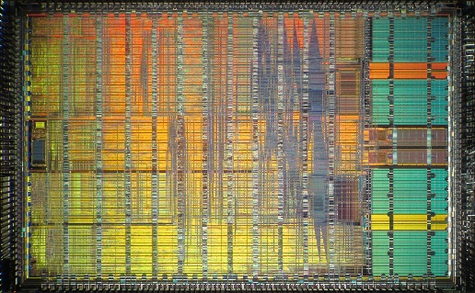
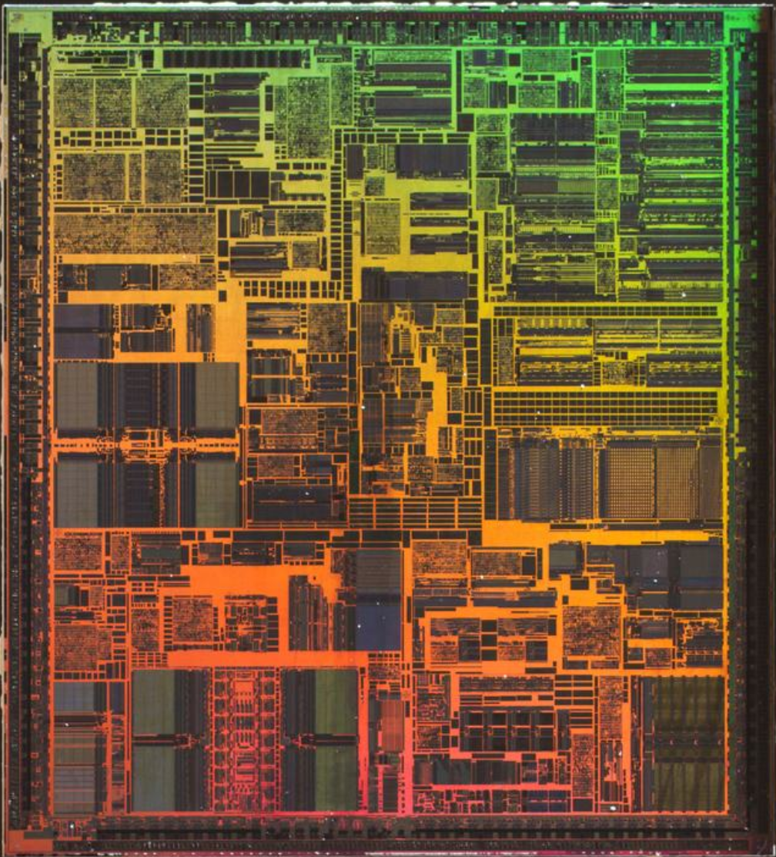
Ancient Superscalar Architecture
PowerPC 6XX
Six independent execution units:
Branch execution unit
Load/store unit
Three integer units
Floating point unit
Out-of-order issue
Pentium I/II
P-I: Three independent units
P-II: out-of-order, five instructions can be issued in a cycle

Slide 27


VLIW
Static multiple-issue processors (decision making at compile time by the compiler)
Intel Itanium series for the IA-64 ISA
– EPIC (Explicit Parallel Instruction Computer)

Slide 28
VLIW: Very Long Instruction Word
Key Idea: Replace a traditional sequential ISA with a new ISA that enables the compiler to encode instruction-level parallelism (ILP) directly in the hardware/software interface
VLIW Compiler
VLIW Processor
C Program
for(i=0;i<n;i++)
dest[i]=
src[i]*coeff;
VLIW ISA
Find independent operations
Schedule
operations
Direct execution
Sub-instructions within a long instruction must be independent
Multiple “sub-instructions” can be packed into one long instruction
Each “slot” in a VLIW instruction for a specific functional unit

Slide 29
VLIW Hardware (TinyRV1 VLIW Processor)
Y-pipe
Y-pipe
X-pipe
L-pipe
X-pipe
L-pipe
S-pipe
S-pipe
VLIW
Instruction
mul x1,x2,x3
add x4, x1, x5
lw x6, 0(x7)
sw x6, 0(x8)
mul x1,x2,x3
add x4, x1, x5
lw x6, 0(x7)
sw x6, 0(x8)
Y0
Y1
Y2
Y3
X0
F
D
W
mul
4
4
add
lw
sw
4
L0
L1
S0
S1
TinyRV1 VLIW ISA
No hazard checking, assume ISA enables setting bypass muxing
4-cycle Y-pipe
, 1-cycle X-pipe
, 2-cycle L-pipe
, 2-cycle S-pipe

Slide 30
VLIW Software (Compilation Techniques)
Key Questions:
How do we find independent instructions to fetch/execute?
How to enable more compiler optimizations?
Key Ideas:
Get rid of control flow
Predicated execution, loop unrolling
Optimize frequently executed code-paths
Trace scheduling
Others: Software pipelining

Slide 31
Compile Technique1: Loop Unrolling
Key idea: Unroll loop to perform M iterations at once
Limitations: Code growth, does not handle inter-iteration
Optimized C code
VLIW Compiler
For (i=0; i<N; i+=4)
Original C code
{
Loop Unrolling…
B[i] = A[i]+C;
B[i+1]=A[i+1]+C;
B[i+2]=A[i+2]+C;
B[i+3]=A[i+3]+C;
For (i=0; i<N; i++)
B[i] = A[i] + C;
}
Expose more Instruction-level Parallelism!

Slide 32
Compile Technique2: Predicated Execution
Key idea: Eliminate hard-to-predict branches by converting control dependence to data dependence
(normal branch code)
(predicated code)
T
A
Original C code
N
A
if (cond) {
b = 0;
}
else {
b = 1;
}
B
C
B
C
D
D
A
A
p1 = (cond)
branch p1, TARGET
p1 = (cond)
B
mov b, 1
jmp JOIN
B
(!p1) mov b,1
C
TARGET:
mov b, 0
C
(p1) mov b,0
Notes:
谓词执行或者判定式执行

Slide 33
Compile Technique2: Predicated Execution
Key idea: Eliminate hard-to-predict branches by converting control dependence to data dependence
Limitations: Reduces perf. if misprediction cost < benefit
A
Predicated Execution
Fetch Decode Rename Schedule RegisterRead Execute
C
B
F
E
E
F
D
F
D
E
F
C
A
B
A
E
F
C
D
B
F
D
E
B
C
A
F
E
C
D
A
B
E
D
B
C
A
D
C
A
B
C
B
A
B
A
E
A
A
F
D
E
F
C
D
E
B
C
D
A
B
A
C
D
A
B
B
A
C
B
C
nop
D
Branch Prediction
Fetch Decode Rename Schedule RegisterRead Execute
E
F
E
D
B
A
F
Pipeline flush!!
Credits: MICRO’06 Diverge-Merge Processor (DMP) UT-Austin

Slide 34
Advantages & Disadvantages of VLIW
Advantages
Simpler hardware (potentially less power hungry)
Potentially more scalable
Allow more instr’s per VLIW bundle and add more FUs
Disadvantages
Programmer/compiler complexity and longer compilation times
Deep pipelines and long latencies can be confusing (making peak performance elusive)
Lock step operation, i.e., on hazard all future issues stall until hazard is resolved (hence need for predication)
Object (binary) code incompatibility
Needs lots of program memory bandwidth
Code bloat
Noops are a waste of program memory space
Loop unrolling to expose more ILP uses more program memory space

Slide 35
CISC vs RISC vs SuperScalar vs VLIW
 | CISC | RISC | Superscalar | VLIW
Instr size | variable size | fixed size | fixed size | fixed size (but large)
Instr format | variable format | fixed format | fixed format | fixed format
Registers | few, some special | many GP | GP and rename (RUU) | many, many GP
Memory reference
Key Issues | decode complexity | data forwarding, hazards | hardware dependency resolution | (compiler) code scheduling
Instruction flow
variable size | fixed size | fixed size | fixed size (but large)
variable format | fixed format | fixed format | fixed format
few, some special | many GP | GP and rename (RUU) | many, many GP
embedded in many instr’s | load/store | load/store | load/store
decode complexity | data forwarding, hazards | hardware dependency resolution | (compiler) code scheduling
IF
ID
EX
M
WB
IF
ID
EX
M
WB
IF
ID
EX
M
WB
IF
ID
EX
M
WB
EX
M
WB
IF
ID
EX
M
WB
IF
ID
EX
M
WB
IF
ID
EX
M
WB
IF
ID
EX
M
WB
IF
ID
EX
M
WB
EX
M
WB

Slide 36
Static Scheduling

Slide 37
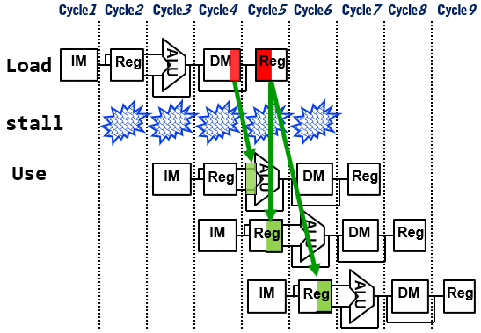
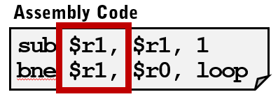
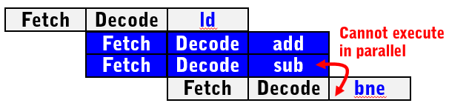
Recall: Data-Dependence Stalls
Previously, we tried to reduce the program execution time with
But, there are limits due to data-dependency
Single-issue pipeline (Lecture 3)
Multiple-issue; Superscalar
(Lecture 4)
Load-Use (RAW)
Limits on WAW
What else?
When no bypassing exists
Long-latency instructions
What else?
Instructions executing in a same cycle shouldn't have RAW/WAR

Slide 38
Solution: Instruction Scheduling
Static Scheduling
Dynamic Scheduling
Unscheduled
program
Compile-time
Static
Scheduler
Conservative schedule
High-quality schedule
Dynamic
Scheduler
Run-time
Functional Units
Functional Units
Low-complexity implementation
High-complexity implementation

Slide 39
Static Scheduling
Statically schedule inst. from the compiler angle! (for data-dep.)
Static Scheduling
Dynamic Scheduling
Unscheduled
program
Compile-time
Static
Scheduler
Dynamic
Scheduler
Run-time
Functional Units
Functional Units

Slide 40
What is Compiler?
Compiler translates a program written in a high-level language into an equivalent program in a target language
Compiler
ChaseLab.c
ChaseLab.exe
void main()
{
printf(“Yay!”); }
11011001
01000100
00010000
10101011
Source file
Machine code

Slide 41
Performance Impacts of Compiler
Compiler optimizations may improve performance significantly
Performance can be improved 10x by advanced compiler optimization!
Adding OpenMP
10x
Compiler directives, minor source changes
O3 – Enable advanced optimizations
4x
Original source, default options
2.5x
Legacy system
(8 CPUs)
1.2x
1x
Compiler
Compiler
Compiler
Compiler
Source: Intel Corp. 2006 (Itanium® 2 4 CPU)

Slide 42
What is Compiler Optimization?
The most common requirement is to minimize the time taken to execute a program with the restriction that the result must be correct
Conventional optimization
techniques
Execution Time = IC * CPI * CCT
IC: Instruction Count
CPI: Cycles per Instruction
CCT: Clock Cycle Time
Optimization
techniques for ILP
Would be improved with compiler optimizations

Slide 43
Compiler Optimization = Graph Problem!
The input of optimization process is control flow graph (CFG)
A directed graph where
Each node represents a statement
Edges represent control flow
x:= a+b
x:= a+b
y:=a*b
y:= a*b
x:= a+b;
y:= a*b;
while (y>a) {
a:=a+1;
x:=a+b;
}
CFG Generation
CFG variations
y>a
y>a
With basic blocks
a:=a+1
a:=a+1
x:=a+b
Basic blocks: a sequence of instructions w/ no branches into or out of the block
Loop
x:=a+b

Slide 44
Simple Loop Example
Simple loop:
for(i=1; i<=1000; i++)
x[i]=x[i] + s;
1. Loop: LD F0, 0(R1)
2. Stall
3. ADDD F4,F0,F4
4. Stall
5. Stall
6. SD F4,0(R1)
7. SUBI R1,R1,#8
8. Stall
9. BNEZ R1,R2,Loop
10. Stall
Compilation
w/ a vanilla compiler
Loop: L.D F0, 0(R1)
ADD.D F4,F0,F4
S.D F4 0(R1)
SUBI R1,R1,#8
BNEZ R1,R2,Loop
;F0=array el.
;add scalar in F2
;store result
;decrement pointer
Execute in machine
;branch
Our machine specification:
Instruction Instruction Delay in producing result using the result clock cycles
FP ALU op Another FP ALU op 3
FP ALU op Store double 2
Load double FP ALU op 1
Load double Store double 0
Integer op Integer op 0
FP ALU op Branch 1
Branch 1
10 clocks per iteration (5 stalls) => Can we rewrite the code to minimize stalls?

Slide 45
Scheduled Loop Body (with CFG)
LD F0,0(R1)
LD F0,0(R1)
Clock Cycle
Clock Cycle
5 stalls → 1 stalls!
ADDD F4,F0,F2
ADDD F4,F0,F2
Utilize delayed
branch slot
SD F4,0(R1)
Compiler optimization
SD F4,0(R1)
8
SUBI R1,R1,#8
SUBI R1,R1,#8
BNEZ R1,R2,Loop
BNEZ R1,R2,Loop
Notes:
To schedule the delayed branch, the compiler had to determine that it could swap the SUBI and SD by changing the address to which the SD stored: 0(R1) is replaced with 8(R1). It is not a trivial observation, since most compilers would see that SD depends on SUBI and would refuse to interchange them. However, the smarter compilers could figure out the relationship and performs the interchange.

Slide 46
Goal of Multi-Issue Scheduling
Place as many independent instructions in sequence
“as many” → up to execution bandwidth
Don’t need 7 independent instructions on a 3-wide machine
Avoid pipeline stalls
If compiler is really good, we should be able to get high performance on an in-order superscalar processor
In-order superscalar provides execution bandwidth, compiler provides dependence scheduling

Slide 47
Why this Should work?
Compiler has “all the time in the world” to analyze instructions
Hardware must do it in < 1ns
Compiler can “see” a lot more
Compiler can do complex inter-procedural analysis, understand high-level behavior of code and programming language
Hardware can only see a small number of instructions at a time
Static detection & resolution of dependencies (Compiler)
Dynamic detection & resolution of dependencies (HW)
Input code
Input code
ILP
compiler
Issue
window
Instruction issue unit of the processor
Software window
Execution
window

Slide 48
Why might this not work?
Can’t always schedule around branches
limited access to dynamic information (profile-based info)
Perhaps none at all, or not representative
Ex. Branch T in 1st ½ of program, NT in 2nd ½, looks like 50-50 branch in profile
Not all stalls are predicable
Cannot react to dynamic events like data cache misses
Although there are limits of static scheduling (done by compiler), there is still a room to reap the benefits.
Let’s check the detail techniques!

Slide 49
Conventional Optimization Techniques
Execution Time = IC * CPI * CCT
IC: Instruction Count
CPI: Cycles per Instruction
CCT: Clock Cycle Time
We mainly focus on Instruction Count!

Slide 50
Technique1: Register Renaming
Observation1: weird register allocation
Largely limited by architected registers
Could possibly cause more spills/fills
Observation2: Dynamic Dead Code (branches)
Code motion may be limited
R8
R1=R2+R3
BEQZ R9
Need to allocate registers differently
Causes unnecessary execution of LOAD when branch goes left
R8
R1=LOAD 0[R6]
R5=R1-R4
Notes:
Reduced Dead Code: Register renaming can lead to the elimination of some dynamic dead code. When a register is renamed, the processor can track whether the original register's value is needed anymore. If not, the instructions that compute this value can be regarded as dead code and can be removed or ignored.

Slide 51
Register Renaming & Scheduling
Same functionality, no stalls
Schedule to remove stall
A: R1 = R2 + R3
B: R4 = R1 – R5
C: R1 = LOAD 0[R7]
D: R2 = R1 + R6
E: R6 = R3 + R5
F: R5 = R6 – R4
A: R1 = R2 + R3
B: R4 = R1 – R5
C’: R8 = LOAD 0[R7]
D’: R2 = R8 + R6
E’: R9 = R3 + R5
F’: R5 = R9 – R4
A: R1 = R2 + R3
C’: R8 = LOAD 0[R7]
B: R4 = R1 – R5
E’: R9 = R3 + R5
D’: R2 = R8 + R6
F’: R5 = R9 – R4
Renaming
No need to same
No need to same
CFG view
A
A
A
C’
Renaming
Scheduling
B
C
B
C
B
E’
D
E
D
E
D’
F
F
F

Slide 52

Technique2: Loop Unrolling
Transforms an M-iterations loop into a loop with M/N iterations
We say that the loop has been unrolled N times
Some compilers can do this (gcc –funroll-loops) or you can do it manually (above)
for(i=0;i<100;i+=4){
a[i]*=2;
a[i+1]*=2;
a[i+2]*=2;
a[i+3]*=2;
}
for(i=0;i<100;i++)
a[i]*=2;

Slide 53
Why Loop Unrolling? (1)
Get rid of small loops
a[0]*=2;
a[1]*=2;
a[2]*=2;
a[3]*=2;
for(i=0;i<4;i++)
a[i]*=2;
for(0)
for(1)
for(2)
for(3)
Difficult to schedule/hoist
insts from bottom block to
top block due to branches
Easier: no branches in the way

Slide 54
Why Loop Unrolling? (2)
Less loop overhead
Allow better scheduling of instructions
4 branches -> 1 branches
L.D F0,0(R1)
ADD.D F0,F0,F2
S.D F0,0(R1)
DADDUI R1,R1,#-8
BNE R1, R2, Loop
L.D F0,0(R1)
ADD.D F0,F0,F2
S.D F0,0(R1)
L.D F0,-8(R1)
ADD.D F0,F0,F2
S.D F0,-8(R1)
L.D F0,-16(R1)
L.D F0,0(R1)
ADD.D F0,F0,F2
S.D F0,0(R1)
DADDUI R1,R1,#-8
BNE R1, R2, Loop
Unroll
ADD.D F0,F0,F2
S.D F0,-16(R1)
L.D F0,-24(R1)
ADD.D F0,F0,F2
S.D F0,-24(R1)
DADDUI R1,R1,#-32
L.D F0,0(R1)
ADD.D F0,F0,F2
S.D F0,0(R1)
DADDUI R1,R1,#-8
BNE R1, R2, Loop
BNE R1, R2, Loop
L.D F0,0(R1)
ADD.D F0,F0,F2
S.D F0,0(R1)
DADDUI R1,R1,#-8
BNE R1, R2, Loop

Slide 55

Loop Unrolling: Problems
Program size becomes larger (code bloat)
Q1. What if N is not a multiple of M?
Q2. Or What if N is unknown at compiler time?
Q3. Or What if it is a while loop?
j1=j-j%4;
for(i=0;i<j1;i+=4){
a[i]*=2;
a[i+1]*=2;
a[i+2]*=2;
a[i+3]*=2;
}
for(i=j1;i<j;i++)
a[i]*=2;
for(i=0;i<j;i++)
a[i]*=2;
Unroll until value`i` is multiple of 4
Remained for another for loop

Slide 56
Technique3: Function Inlining
Goal: sort of like “unrolling” a function
Problems: primarily code bloat
Remove function call overhead
CALL/RETN (and possible branch misprds)
Argument/ret-val passing, stack allocation, and associated spills/fills of caller/calle-save regs
Larger block of instructions for scheduling
Inline Function
Normal Function
Start
Start
call
myfunc()
{
// body
}
Main function body
{
}
myfunc()
{
// body
}
myfunc();
myfunc()
return
Stop
Stop

Slide 57
Technique4: Tree Height Reduction
Goal: shorten critical path(s) using associativity law
Limitations: not all math operations are associative!
C defines L-to-R semantics for most arithmetic
Associativity
R8=((R2+R3)+R4)+R5
R8=(R2+R3)+(R4+R5)
I1
I1
I2
I1:ADD R6,R2,R3
I2: ADD R7,R6,R4
I3: ADD R8,R7,R5
ADD R6,R2,R3
ADD R7,R4,R5
ADD R8,R7,R6
I2
I3
I3

Slide 58
Optimization Techniques for ILP
Execution Time = IC * CPI * CCT
IC: Instruction Count
CPI: Cycles per Instruction
CCT: Clock Cycle Time
We mainly focus on Cycles/Instruction!

Slide 59
Scheduling for Inst-Level Parallelism
Goal: Schedule instructions to finish whole program as soon as possible
Two types of static ILP scheduling
Static ILP Scheduling
Global Scheduling
Software Pipelining
Target: DAG (Directed Acyclic Graph) of a general purpose integer program with many conditional branches
Target: loop in any code

Slide 60
Technique1: Global Scheduling
Q. What is the general size of basic block?
In general, the basic block size of non-numeric computation program is 5~20 instructions
[REMIND] Basic blocks: a sequence of instructions w/ no branches into or out of the block
➔ No good enough # of instructions which can be processed in parallel
Q. Why global scheduling?
As the basic block size is too small to find out independent instructions, let’s schedule the instructions that exist across all other basic blocks (e.g., in global)
x:= a+b
y:=a*b
y>a
Global Scheduling
a:=a+1
x:=a+b
Will be covered
In this lecture
Trace-based Scheduling
DAG-based schdeuling

Slide 61
Trace-based Scheduling
This is one technique for global scheduling
Works on all code, not just loops
Take an execution trace of the common case
Schedule code as if it had no branches
Check branch condition when convenient
If mispredicted, clean up the mess
Q. How do we find the “common case”
A. Program analysis or profiling

Slide 62
Example of Trace Scheduling
a=log(x);
if(b>0.01){
c=a/b;
}else{
c=0;
}
y=sin(c);
a=log(x);
c=a/b;
y=sin(c);
if(b<=0.01)
goto fixit;
90%
90%
10%
10%
fixit: c=0;
y=0; // sin(0)
Suppose profile says that b>0.01 90% of the time
Now, we have a larger basic block for the trace scheduling & optimizations

Slide 63
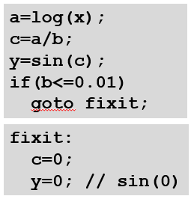
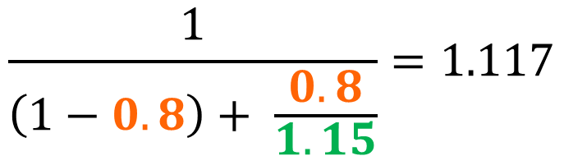
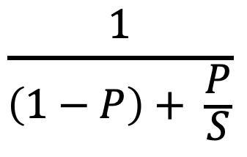
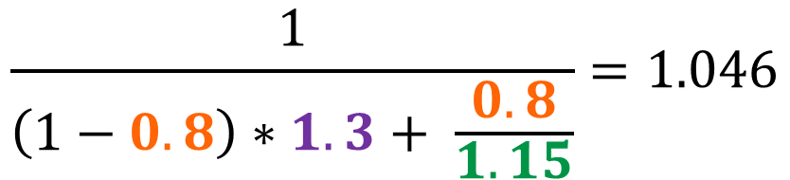
Pay Attention to Cost of Fixing
[REMIND] Amdahl’s law
$$\frac{1}{\left(1−P\right)+ \frac{P}{S}}$$
= System performance
P: Fraction of enhanced component
S: Speedup of enhanced component
Assume the code for b > 0.01 accounts for 80% of the time
Optimized trace runs 15% faster
But, fix-up code may cause the remaining 20% of the time to be even slower!
Assume fixup code is 30% slower
$$\frac{1}{\left(1−0.8\right)+ \frac{0.8}{1.15}}=1.117$$
$$\frac{1}{\left(1−0.8\right)∗1.3+ \frac{0.8}{1.15}}=1.046$$
11.7%
4.6%
Around 2/3 of the benefit removed

Slide 64
Technique2: Software Pipelining
Design: overlapping different iterations by starting the next iteration before the current iteration in the loop ends
Consider a graphical view of the overlay of iterations:
interation1
interation2
Prolog
interation3
interation4
Inst1
Inst2
Inst3
Inst4
interation5
Kernel
Inst1
Inst2
Inst3
Inst4
interation6
Inst1
Inst2
Inst3
Inst4
Epilog
Only the shaded part, the loop kernel, involves executing the full width of the VLIW instruction.
The loop prolog and epilog contain only a subset of the instructions.
“ramp up” and “ramp down” of the parallelism.

Slide 65
Scheduling Loop Unrolled Code
Unroll 4 ways
loop: ld f1, 0(r1)
ld f2, 8(r1)
ld f3, 16(r1)
ld f4, 24(r1)
add r1, 32
fadd f5, f0, f1
fadd f6, f0, f2
fadd f7, f0, f3
fadd f8, f0, f4
sd f5, 0(r2)
sd f6, 8(r2)
sd f7, 16(r2)
sd f8, 24(r2)
add r2, 32
bne r1, r3, loop
Int1
Int 2
M1
M2
FP+
FPx
loop:
ld f1
Assumption:
ld: 2 cycle
ld f2
ld f3
add r1
ld f4
fadd f5
Schedule
fadd f6
fadd f7
fadd f8
sd f5
sd f6
Assumption:
fadd: 3 cycle
sd f7
add r2
bne
sd f8

Slide 66
Software Pipelining
Int1
Int 2
M1
M2
FP+
FPx
Unroll 4 ways first
loop:
ld f1
loop: ld f1, 0(r1)
ld f2, 8(r1)
ld f3, 16(r1)
ld f4, 24(r1)
add r1, 32
fadd f5, f0, f1
fadd f6, f0, f2
fadd f7, f0, f3
fadd f8, f0, f4
sd f5, 0(r2)
sd f6, 8(r2)
sd f7, 16(r2)
sd f8, 24(r2)
add r2, 32
bne r1, r3, loop
ld f2
ld f3
add r1
ld f4
ld f1
fadd f5
ld f2
fadd f6
Schedule
ld f3
fadd f7
add r1
ld f4
fadd f8
ld f1
sd f5
fadd f5
ld f2
sd f6
fadd f6
add r2
ld f3
sd f7
fadd f7
bne
ld f4
sd f8
fadd f8
sd f5
fadd f5
sd f6
fadd f6
add r2
sd f7
fadd f7
bne
sd f8
fadd f8
sd f5

Slide 67
Loop Unrolling vs. Software Pipelining
Startup overhead
Wind-down overhead
performance
Loop Unrolling
time
Loop Iteration
performance
Software Pipelining
Loop Iteration
time
Software pipelining pays startup/wind-down costs only once per loop, not once per iteration

Slide 68
Recall: Why Compiler Might not Work
Can’t always schedule around branches
limited access to dynamic information (profile-based info)
Perhaps none at all, or not representative
Ex. Branch T in 1st ½ of program, NT in 2nd ½, looks like 50-50 branch in profile
Not all stalls are predicable
Cannot react to dynamic events like data cache misses

